Slide 1
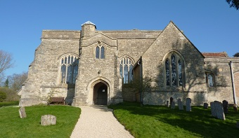
Welcome to the Chilton Church Quiz
Saturday 27th April 2019

Slide 2
Your Challenge
To try to accumulate at least 20,000 points over the next 8 rounds.

Slide 3
Celebrating TV Quiz Shows
A Question of Sport
Only Connect
University Challenge
Sale of the Century
Double your Money
Who Dares Wins
Pointless
Winner Takes All

Slide 4
A Question of Sport 2nd December 1968 – present day

Slide 5
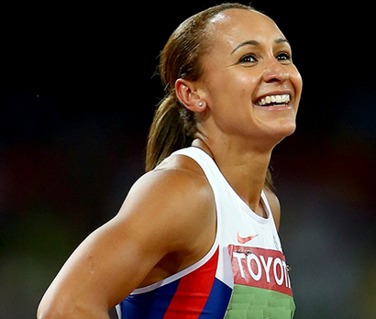
Question of Sport Name the Famous Sportswomen 5 pts per woman (Bonus 5 pts for their Nationality) Your target in this round is 150 pts
1 | 2

Slide 6
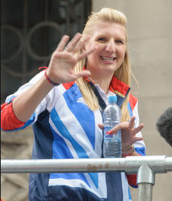
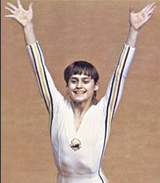
Question of Sport Famous Sportswomen 5 pts per woman (Bonus 5 pts for their Nationality)
3 | 4

Slide 7
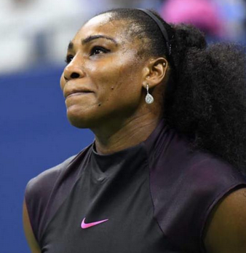
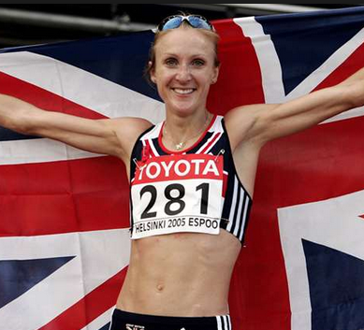
Question of Sport Famous Sportswomen 5 pts per woman (Bonus 5 pts for their Nationality)
5 | 6

Slide 8
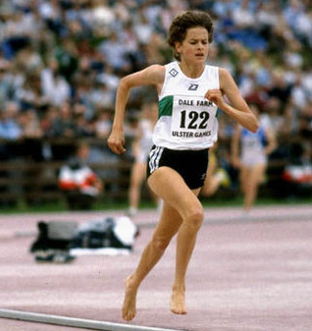
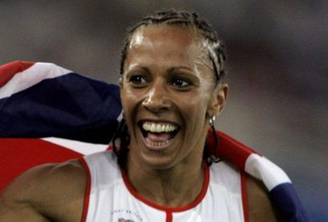
Question of Sport Famous Sportswomen 5 pts per woman (Bonus 5 pts for their Nationality)
7 | 8

Slide 9
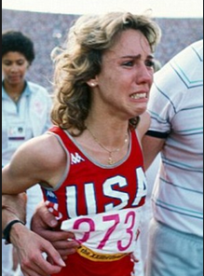
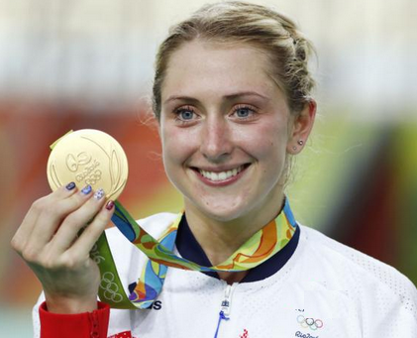
Question of Sport Famous Sportswomen 5 pts per woman (Bonus 5 pts for their Nationality)
9 | 10

Slide 10
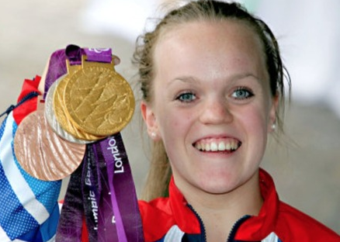
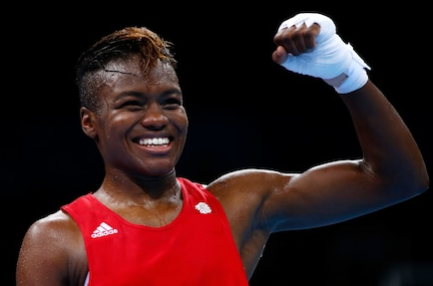
Question of Sport Famous Sportswomen 5 pts per woman (Bonus 5 pts for their Nationality)
11 | 12

Slide 11
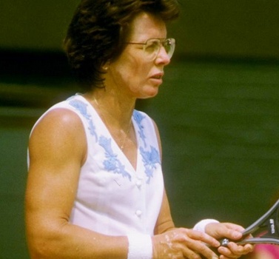
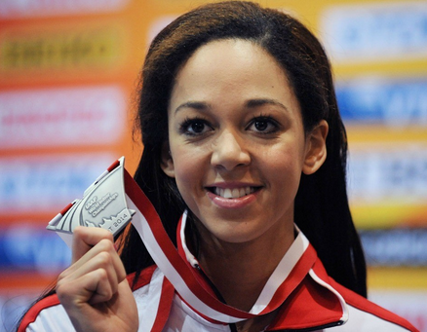
Question of Sport Famous Sportswomen 5 pts per woman (Bonus 5 pts for their Nationality)
13 | 14

Slide 12
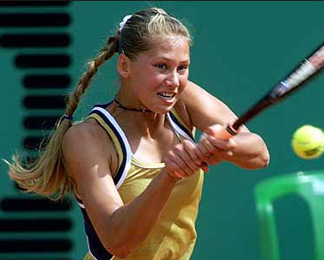
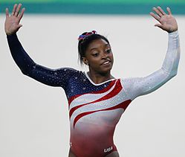
Question of Sport Famous Sportswomen 5 pts per woman (Bonus 5 pts for their Nationality)
15 | 16

Slide 13
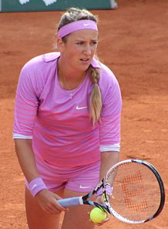
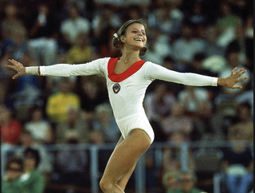
Question of Sport Famous Sportswomen 5 pts per woman (Bonus 5 pts for their Nationality)
17 | 18

Slide 14
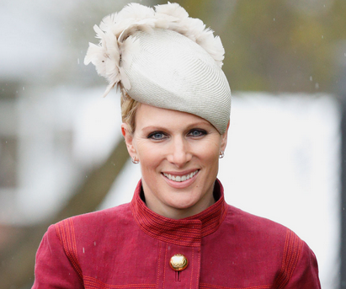
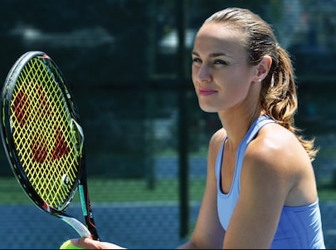
Question of Sport Famous Sportswomen 5 pts per woman (Bonus 5 pts for their Nationality)
19 | 20

Slide 15
5 pts per competitor (Bonus 5 pts per Nationality)
1 | Maria Sharapova | Russian | 11 | Ellie Simmons | English
2 | Jessica Ennis-Hill | English | 12 | Nicola Adams | English
3 | Rebecca Adlington | English | 13 | Billy Jean King | USA
4 | Nadia Comanaci | Romanian | 14 | Katarina Johnson Thompson | English
5 | Serena Williams | USA | 15 | Anna Kournikova | Russian
6 | Paula Radcliffe | English | 16 | Simone Biles | USA
7 | Zola Budd | S African | 17 | Victoria Azarenka | Belarus
8 | Kelly Holmes | English | 18 | Olga Korbut | Russia
9 | Mary Decker | USA | 19 | Zara Phillips | English
10 | Laura Kenny | English | 20 | Martina Hingis | Switzerland

Slide 16
Your target
Your target was 150 points.
How did you do?

Slide 17
Only Connect 15th September 2008 – present

Slide 18
The Wild Wall You are given a wall containing 6 animals, 6 life spans, 6 masses, 6 speeds and 6 gestation periods. Your task is to match each animal with their life spans, mass, speed and gestation period.
Animal | Life span (yrs) | Adult mass (kg) | Speed (km/h) | Gestation (days)
African Elephant | 9-12 | 40-70 | 25 | 90-98
Cheetah | 10-14 | 70-100 | 32 | 95-160
Lion | 20 | 190 | 50 | 105-110
Northern Giraffe | 25 | 800 | 60 | 450
Panda | 40-50 | 2300 | 80 | 515
White Rhino | 60-70 | 6000 | 100-120 | 670

Slide 19
The Wild Wall Scoring system
6 lines to complete
Any wrong answer in a line scores 0
2 correct in a line scores 20 pts
3 correct in a line scores 40 pts
A fully correct line scores 100 pts
Maximum score for a fully completed wall 600 pts
Your target, at least 300 points

Slide 20
The Wild Wall
Animal | Life span (yrs) | Adult mass (kg) | Speed (km/h) | Gestation (days)
African Elephant
Cheetah
Lion
Northern Giraffe
Panda
White Rhino

Slide 21
The Wild Wall
Let thinking time commence

Slide 22
The Wild Wall (All jungled up)
Animal | Life span (yrs) | Adult mass (kg) | Speed (km/h) | Gestation (days)
African Elephant | 9-12 | 40-70 | 25 | 90-98
Cheetah | 10-14 | 70-100 | 32 | 95-160
Lion | 20 | 190 | 50 | 105-110
Northern Giraffe | 25 | 800 | 60 | 450
Panda | 40-50 | 2300 | 80 | 515
White Rhino | 60-70 | 6000 | 100-120 | 670

Slide 23
The Wild Wall (Completed wall unjungled)
Animal | Life span (yrs) | Adult mass (kg) | Speed (km/h) | Gestation (days)
African Elephant | 60-70 | 6000 | 25 | 670
Cheetah | 9-12 | 40-70 | 100-120 | 90-98
Lion | 10-14 | 190 | 80 | 105-110
Northern Giraffe | 25 | 800 | 60 | 450
Panda | 20 | 70-100 | 32 | 95-160
White Rhino | 40-50 | 2300 | 50 | 515

Slide 24
Your target
After completing this round your overall target was 450 points.
How well did you do?

Slide 25
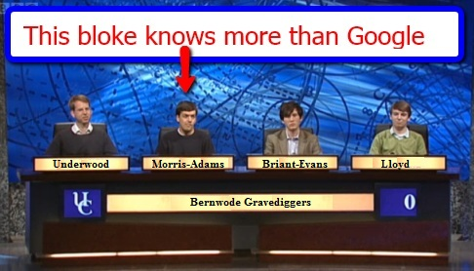
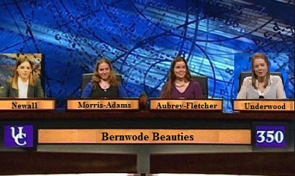
University Challenge 1962-1987 & 1994- present

Slide 26
University Challenge Football teams with unique second names e.g. If the question was Manchester you would leave it blank, because neither City nor United are unique 30 pts per correct answer, but lose 30 pts for each incorrect answer
Accrington |  | Nottingham
Aston |  | Plymouth
Bristol |  | Preston
Charlton |  | Queens Park
Coventry |  | Rotherham
Crewe |  | Sheffield
Crystal |  | Tottenham
Forest Green |  | West Bromwich
Milton Keynes |  | Wycombe
Newport |  | Yeovil

Slide 27
Your target
Your target on this round is 450 points out of a maximum of 600 pts
Let thinking time commence.

Slide 28
30 pts per correct answer, but lose 30 pts for each incorrect answer
Accrington | Stanley | Nottingham | Forest
Aston | Villa | Plymouth | Argyle
Bristol |  | Preston | North End
Charlton |  | Queens Park | Rangers
Coventry |  | Rotherham
Crewe | Alexandra | Sheffield | Wednesday
Crystal | Palace | Tottenham | Hotspurs
Forest Green |  | West Bromwich
Milton Keynes | Dons | Wycombe
Newport |  | Yeovil
Note that Bristol City and Rovers fail; Charlton Athletic fail because of Oldham Athletic; Coventry City fail; Forest Green Rovers fail; Newport County fail because of Derby County; Rotherham United fail; West Bromwich Albion fail because of Brighton and Burton; Wycombe Wanderers fail because of Bolton; Yeovil Town fail.

Slide 29
Your target
Your target after completing this round was 900 points. How well did you do?

Slide 30
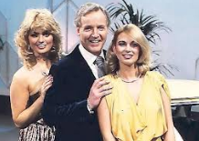
Sale of the Century 1972 – 1983

Slide 31
Sale of the Century
Winners share 1000 pts
4th Round losers 250 pts
3rd Round losers 120 pts
2nd Round losers 80 pts
First Round losers 40 pts
Your target is at least 250 points

Slide 32
ARGOS
All items are taken from the current Argos online catalogue
They are typical items used from daybreak to nightfall.
You have a choice of 3 prices each round.

Slide 33
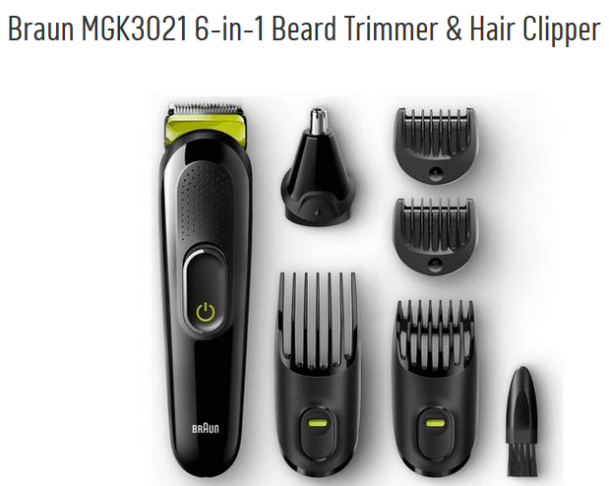
Sale of the century Get the perfect shave in the morning
A Less than £25 B £25 C More than £25

Slide 34
Beard trimmer/hair clippers
A £19.99
Losers get 40 pts

Slide 35
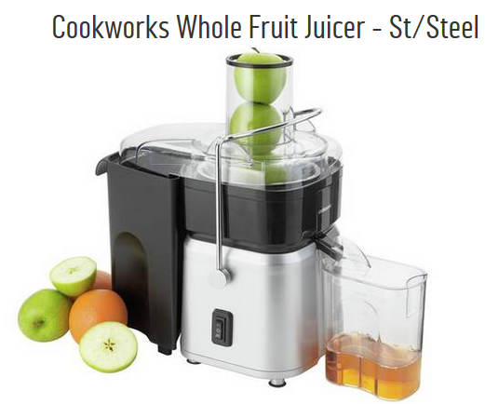
Sale of the Century
A Less Than £50
B £50
C More than £50

Slide 36
Juicer
A £49.99
Losers get 80 pts

Slide 37
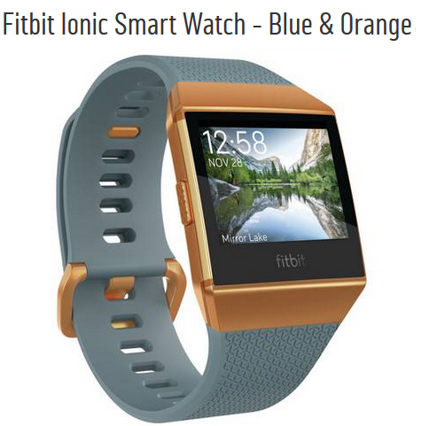
Sale of the Century
A Less than £209.99
B £209.99
C More than £209.99

Slide 38
Fitbit
C £229.99
Losers get 120 pts

Slide 39
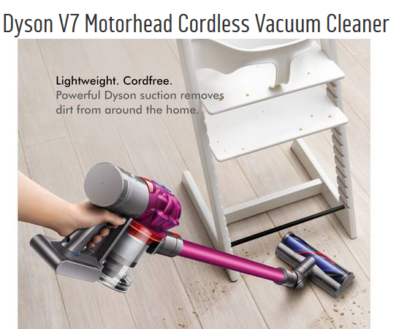
Sale of the Century
A Less than £235
B £235
C More than £235

Slide 40
Cordless vacuum
C £249
Losers get 250 pts
Winners share 1000 pts

Slide 41
Your target
Your overall target to this point was 1150 points.
How well did you do?

Slide 42
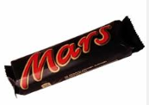
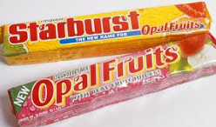
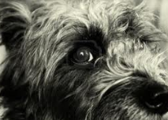
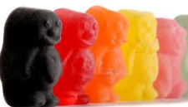
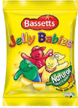
Half way through the show
Lucky

Slide 43
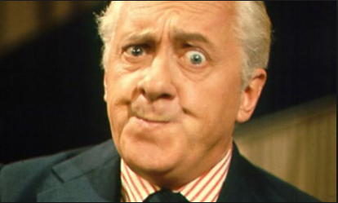
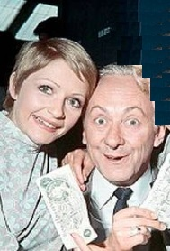
Double Your Money 1955 – 1968
Hughie Green
Monica Rose & Hughie Green

Slide 44
Double Your Money Win from 20pts to 2,560 pts
All questions relate to Pop Groups
Answer 8 questions correctly to win 2,560 pts
You can quit whenever you like to claim your points before the next question is asked.
Your target is 1280 pts

Slide 45
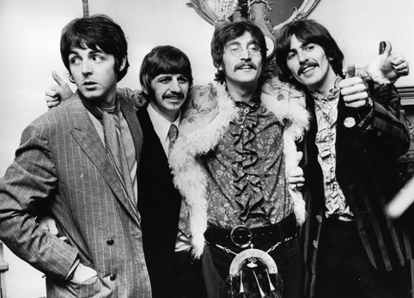
For 20 points
Which group is this?

Slide 46
The Beatles
Double or Quits?

Slide 47
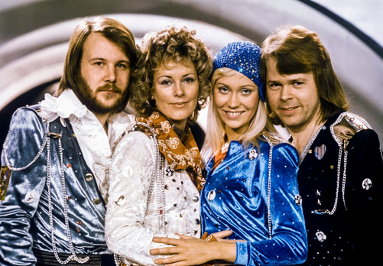
For 40 points
Which group is this?

Slide 48
ABBA
Double or Quits?

Slide 49
For 80 points
Which group is this?

Slide 50
Spice Girls
Double or Quits?

Slide 51
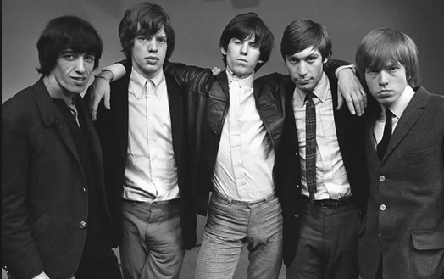
For 160 points
Which group is this?

Slide 52
The Rolling Stones
Double or Quits?

Slide 53
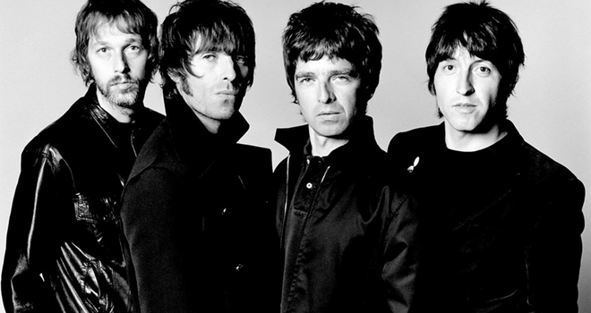
For 320 points
Which group is this?

Slide 54
Oasis
Double or Quits?

Slide 55
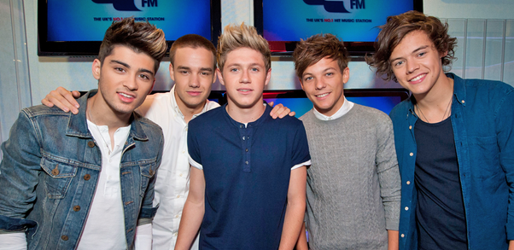
For 640 points
Which group is this?

Slide 56
One Direction
Double or Quits?

Slide 57
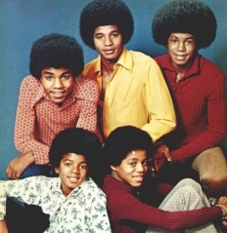
For 1,280 points
Which group is this?

Slide 58
Jackson 5
Double or Quits?

Slide 59
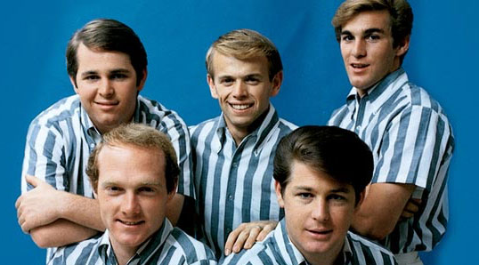
For 2,560 points
Which group is this?

Slide 60
The Beach Boys
Did you hit the jackpot?

Slide 61
Your target
Your overall target to this point was 2430 points
How well did you do?

Slide 62
Who Dares Wins 17th November 2007 - present

Slide 63
Who Dares Wins
The table contains 15 triplets. Your aim is to identify the place in each triplet which is NOT a UK city. How far can your team climb without going wrong?
3 correct = 100 pts
6 correct = 200 pts
9 correct = 400 pts
11 correct = 800 pts
13 correct = 1200 pts
All 15 correct = 2000 pts
Your target is at least 800 pts

Slide 64
Who Dares Wins
2000 | Caerphilly | Carlisle | Chelmsford
 | Lichfield | Lisburn | Luton
1500 | Newport | Newry | Northampton
 | Aberdeen | Aldershot | Armagh
800 | Derry | Doncaster | Dundee
 | Manchester | Middlesbrough | Ripon
400 | St Asaph | Sunderland | Swindon
 | Warrington | Wolverhampton | Worcester
 | Elgin | Ely | Exeter
200 | Perth | Poole | Preston
 | Salford | Southampton | Stockport
 | Cambridge | Oxford | Reading
100 | Southend | St Davids | Stoke
 | Wakefield | Walsall | Wells
 | Basildon | Birmingham | Bradford

Slide 65
Who Dares Wins
Let the thinking commence

Slide 66
Who Dares Wins
2000 | Caerphilly | Carlisle | Chelmsford
 | Lichfield | Lisburn | Luton
1500 | Newport | Newry | Northampton
 | Aberdeen | Aldershot | Armagh
800 | Derry | Doncaster | Dundee
 | Manchester | Middlesbrough | Ripon
400 | St Asaph | Sunderland | Swindon
 | Warrington | Wolverhampton | Worcester
 | Elgin | Ely | Exeter
200 | Perth | Poole | Preston
 | Salford | Southampton | Stockport
 | Cambridge | Oxford | Reading
100 | Southend | St Davids | Stoke
 | Wakefield | Walsall | Wells
 | Basildon | Birmingham | Bradford

Slide 67
Your target
Your overall target to this point was 3230 points
How well did you do?

Slide 68
Pointless 24th August 2009 – present

Slide 69
Word Round
Think of a word in the Oxford English Dictionary ending in
PEL
The longer, more obscure your word the more points you will score.
Points from 100 to 2000 are available.
Your target is at least 500 pts

Slide 70
The Points Board
ANTECHAPEL | 1300 | GRAUPEL | 1700
APPEL | 1400 | IMPEL | 900
CARPEL | 700 | LAPEL | 200
CHAPEL | 100 | PROPEL | 500
COMPEL | 300 | RAPPEL | 1500
CUPEL | 1800 | REEXPEL | 1600
DISPEL | 800 | REPEL | 400
ESTOPPEL | 2000 | SAPROPEL | 1900
EXPEL | 600 | SCALPEL | 1100
GOSPEL | 1000 | STIPEL | 1200

Slide 71
Winner Takes All 1975 – 1988 You are asked a question and given 5 possible answers. You choose and answer and can gamble up to half of your current points on the answer. If correct you gain those points. If incorrect you lose them.

Slide 72
7) Who is the Greek God of love and fertility?
A | Aphrodite
B | Apollo
C | Eros
D | Imeros
E | Pothos

Slide 73
7) Who is the Greek God of love and fertility?
A | Aphrodite (goddess of beauty and illicit sex)
B | Apollo (God of music, poetry and the Arts)
C | Eros
D | Imeros (God of intense erotic desire)
E | Pothos (God of passion)

Slide 74
6) What is the TOTAL number of letters in the titles of these Shakespeare plays?
M… F.. M….
M… O. V….
M… W… O. W….
M… N… D…
M…. A…. A… N…
A | 88
B | 89
C | 90
D | 91
E | None of these

Slide 75
6) What is the TOTAL number of letters in the titles of these Shakespeare plays?
MEASURE FOR MEASURE 17
MERCHANT OF VENICE 16
MERRY WIVES OF WINDSOR 19
MIDSUMMER NIGHTS DREAM 20
MUCH ADO ABOUT NOTHING 19
A | 88
B | 89
C | 90
D | 91
E | None of these

Slide 76
5) If these 5 composers were placed in order of their year of death, who would be in the middle?
A | Bach (Johann Sebastian)
B | Beethoven (Ludwig Van)
C | Handel (George Frederic)
D | Mozart (Wolfgang Amadeus)
E | Schubert (Franz Peter)

Slide 77
5) If these 5 composers were placed in order of their year of death, who would be in the middle?
A | Bach (Johann Sebastian) 1750
B | Beethoven (Ludwig Van) 1827
C | Handel (George Frederic) 1759
D | Mozart (Wolfgang Amadeus) 1791
E | Schubert (Franz Peter) 1828

Slide 78
4) Whose flag is shown below?
A | Indonesia
B | Malaysia
C | Bahrain
D | Liberia
E | Nepal

Slide 79
4) Whose flag is shown below?
A | Indonesia
B | Malaysia
C | Bahrain
D | Liberia
E | Nepal

Slide 80
3) If these politicians were placed in age order, who would be in the middle?
A | Theresa May
B | Nicola Sturgeon
C | Vince Cable
D | Jeremy Corbyn
E | Arlene Foster

Slide 81
3) If these politicians were placed in age order, who would be in the middle?
A | Theresa May (1/10/1956)
B | Nicola Sturgeon (19/7/1970)
C | Vince Cable (9/5/1943
D | Jeremy Corbyn (26/5/1949)
E | Arlene Foster (3/7/1970)

Slide 82
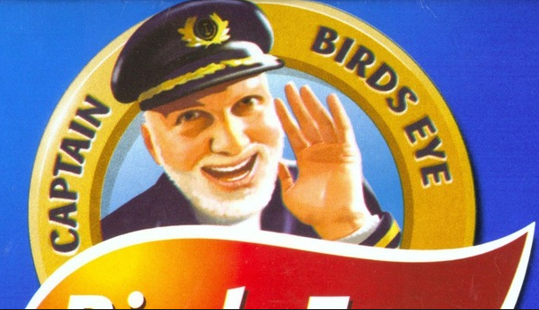
2) What was the first name of ‘Captain Birdseye’?
A | Bill
B | Bertram
C | Claude
D | Clarence
E | Charlie

Slide 83
2) What was the first name of ‘Captain Birdseye’?
A | Bill
B | Bertram
C | Claude
D | Clarence
E | Charlie

Slide 84
1) How many different consonants are there in the first verse of the National Anthem?
A | 13
B | 14
C | 15
D | 16
E | None of these

Slide 85
1) How many different consonants are there in the first verse of the National Anthem?
God save our gracious Queen, Long live our noble Queen, God save the Queen! Send her victorious, Happy and glorious, Long to reign over us, God save the Queen!
A | 13
B | 14
C | 15
D | 16
E | None of these

Slide 86
And finally!!
Did you meet the challenging target of 20,000 points?

Slide 87
That’s all folks!
The quiz is now online at
www.greyhoundderby.com
Scroll down to QUIZ 13

